Slide 1
Vision
Maslab 2013

Slide 2
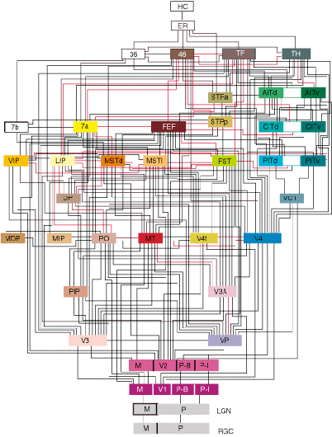
Vision is HARD
Circuitry of macaque visual cortex (Felleman and Van Essen, 1991)

Slide 3
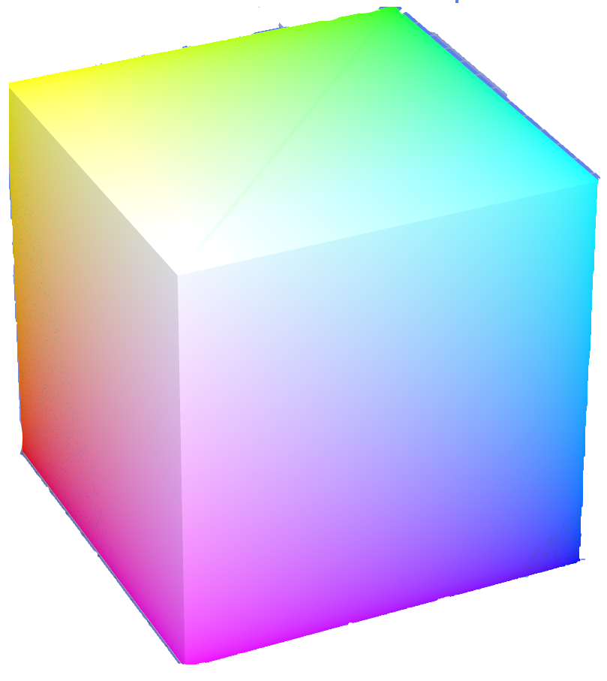
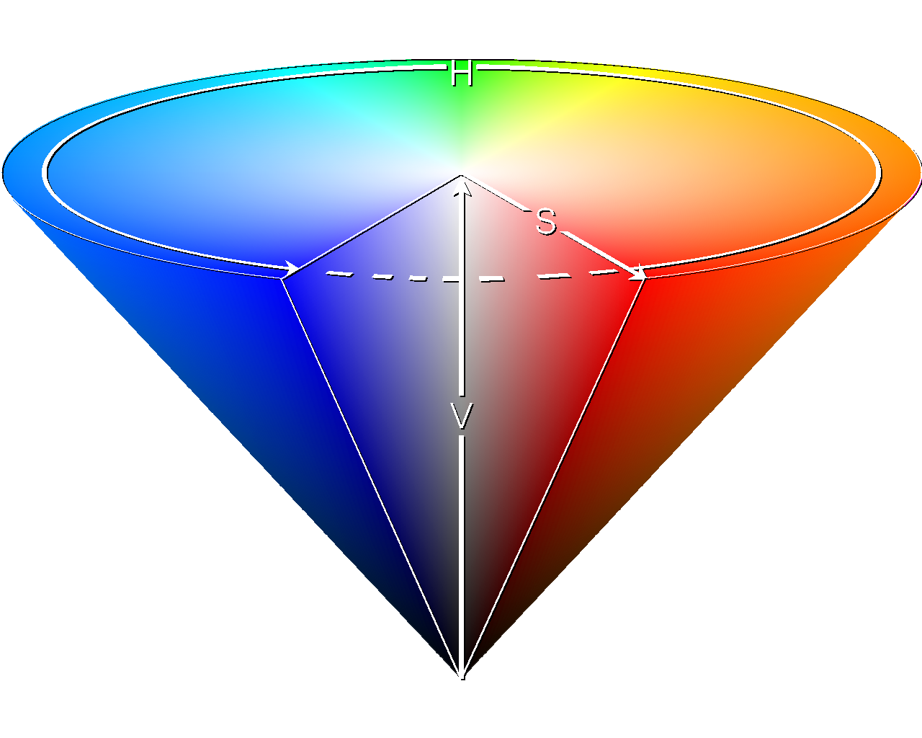
Colorspaces
RGB: red, green, and blue components
HSV: hue, saturation, and value
Your color-detection code will be more resilient to lighting conditions if you use HSV
RGB: 212, 45, 45
HSV: 0, 201, 212
RGB: 102, 0,0
HSV: 0, 255, 102
RGB: 255, 105,105
HSV: 0, 105, 255
RGB: 212, 45, 45
HSV: 0, 201, 212
RGB: 102, 22, 22
HSV: 0, 201, 102
RGB: 102, 0, 0
HSV: 0, 255, 102

Slide 4
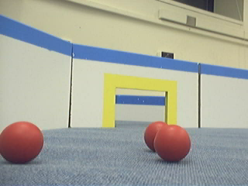
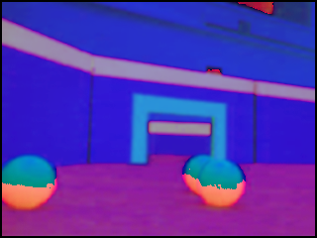
Colorspaces
hue=255
hue=0
Note that because the hue in HSV wraps around, red is both h=255 and h=0

Slide 5
Representation of Color in Bytes
BufferedImage img = …;
img.getRGB(x, y) returns a 32-bit (4-byte) integer
0x00FF0000

Slide 6
Representation of Color in Bytes
Alpha channel: basically transparency, not of interest
0x00FF0000

Slide 7
Representation of Color in Bytes
Red
0x00FF0000
Red: 0xFF=255

Slide 8
Representation of Color in Bytes
Green
0x00FF0000
Red: 0xFF=255 Green: 0x00=0

Slide 9
Representation of Color in Bytes
Blue
0x00FF0000
Red: 0xFF=255 Green: 0x00=0 Blue: 0x00=0

Slide 10
Representation of Color in Bytes
0x00FF0000
0x0000FF00
R: 0xFF=255
G: 0x00=0
B: 0x00=0
R: 0x00=0
G: 0xFF=255
B: 0x00=0
0x000000FF
0x00C20E9F
R: 0x00=0
G: 0x00=0
B: 0xFF=255
R: 0xC2=194
G: 0x0E=14
B: 0x9F=159

Slide 11
Extracting out R, G, B components
BufferedImage img = …;
int rgb = img.getRGB(x,y);
int r = (rgb & 0x00FF0000) >> 16;
int g = (rgb & 0x0000FF00) >> 8;
int b = (rgb & 0x000000FF);
rgb = b + (g << 8) + (r << 16)
Also works if the image is in HSV format; just replace r with h, g with s, and b with v
See Vision tutorial for more info

Slide 12
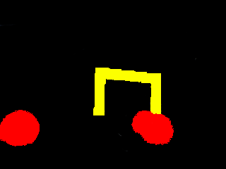
By using color thresholds, (checking that hue is in a certain range), can classify pixels as being Red, Yellow, or other

Slide 13
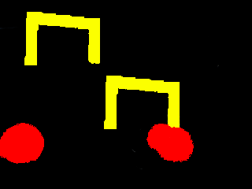
Connected Component Labeling
As a first step in detecting balls and goals, we want to group connected yellow pixels, and connected red pixels into “blobs of interest”
  That is, label each pixel with a number indicating the connected component it belongs to
1
2
3
4

Slide 14
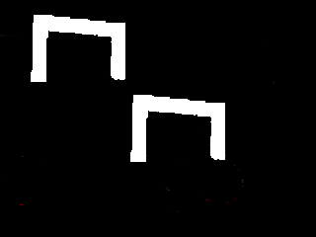

Connected Component Labeling
Various efficient algorithms exist for finding connected components of white pixels in binary images
We can use these algorithms if we consider colors one at a time
1
2
1
2
1
2
3
4

Slide 15

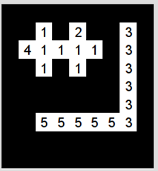
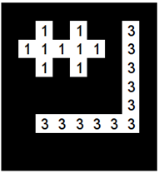
2-pass algorithm for Connected Component Labeling on Binary Images
Pass 1:
If all 4 neighbors are black or unlabeled, assign a new label to current point
If only one neighbor is white, assign its label to current point
If more than one of the neighbors are white, assign one of their labels to current point, and note equivalence of their labels
Pass 2:
Merge labels which were marked as equivalent in the first pass

Slide 16
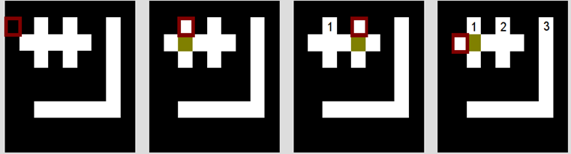
Pass 1:
If all 4 neighbors are black or unlabeled, assign a new label to current point
If only one neighbor is white, assign its label to current point
If more than one of the neighbors are white, assign one of their labels to current point, and note equivalence of their labels
Current point is not white ->
Do nothing
No labeled white neighbors ->
Create label 1
No labeled white neighbors ->
Create label 2
No labeled white neighbors ->
Create label 4

Slide 17
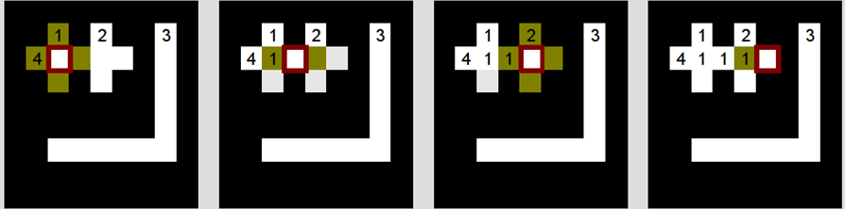
Pass 1:
If all 4 neighbors are black or unlabeled, assign a new label to current point
If only one neighbor is white, assign its label to current point
If more than one of the neighbors are white, assign one of their labels to current point, and note equivalence of their labels
2 white labeled neighbors: 1, 4 ->
Mark 1=4, assign 1
1 white neighbor with label 1 ->
Assign 1
2 white labeled neighbors: 1, 2 ->
Mark 1=2, assign 1
1 white neighbor with label 1 ->
Assign 1

Slide 18
At the end of the first pass, we have marked labels 1, 2, and 4 as equivalent, and have marked labels 3 and 5 as equivalent
In the second pass, we replace all 2s and 4s with 1s, and replace all 5s with 3s

Slide 19
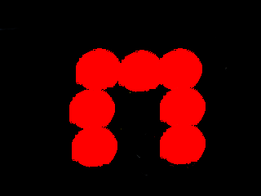
Colors aren’t always enough for segmenting objects
Note that at edges of objects, there is a change in pixel value
Use edge detection for segmenting objects

Slide 20
Image Convolution
Determines pixel value based on neighboring values (relation described by a kernel matrix)
Used in blurring, sharpening, edge detection, etc
0 | 1/6 | 0
1/6 | 1/3 | 1/6
0 | 1/6 | 0
11 | 4 | 13 | 8
7 | 1 | 3 | 9
0 | 5 | 10 | 6
2 | 15 | 12 | 14
Kernel
Source Image (single-chanel, greyscale)
 | 1/3 + 4/6 + 7/6 + 3/6 + 5/6 = 21/6 | 3/3 + 13/6 + 1/6 + 9/6 + 10/6 = 39/6
 | 5/3 + 1/6 + 0/6 + 10/6 + 15/6 = 36/6 | 10/3 + 3/6 + 5/6 + 6/6 + 12/6 = 46/6
Result of convolution
Various workarounds for determining the edge pixels

Slide 21
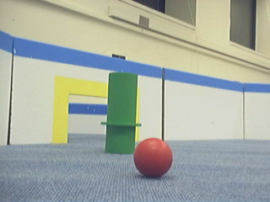
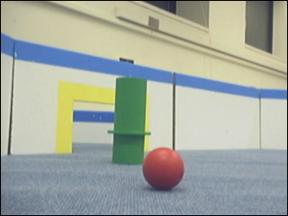
Source Image
0 | 1/6 | 0
1/6 | 1/3 | 1/6
0 | 1/6 | 0
Kernel
Result of convolution (slightly blurred image)

Slide 22
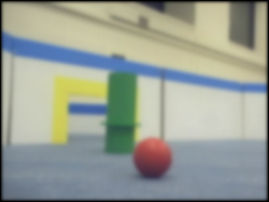
Source Image
0 | 1/6 | 0
1/6 | 1/3 | 1/6
0 | 1/6 | 0
Kernel
Result of convolution applied 20 times (more blurred image)

Slide 23
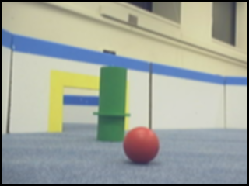
Gaussian Blur
A common preprocessing step before various operations (edge detection, color classification before doing connected component labeling, etc)
2/159 | 4/159 | 5/159 | 4/159 | 2/159
4/159 | 9/159 | 12/159 | 9/159 | 4/159
5/159 | 12/159 | 15/159 | 12/159 | 5/159
4/159 | 9/159 | 12/159 | 9/159 | 4/159
2/159 | 4/159 | 5/159 | 4/159 | 2/159
Source Image
Kernel
Result of convolution with gaussian kernel

Slide 24
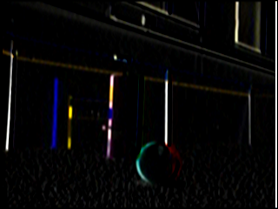
Detecting Horizontal Edges
Use the Sobel operator G_x
-1 | -2 | -1
0 | 0 | 0
1 | 2 | 1
Kernel
Source Image
Result of convolution with sobel operator G_x

Slide 25
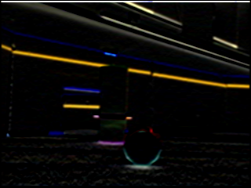
Detecting Vertical Edges
Use the Sobel operator G_y
-1 | -2 | -1
0 | 0 | 0
1 | 2 | 1
Kernel
Source Image
Result of convolution with sobel operator G_y

Slide 26

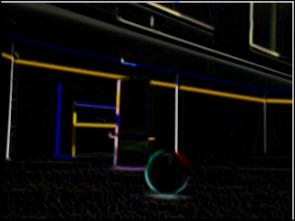
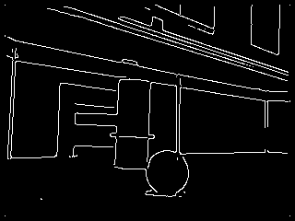
Edge Detection
Get matrices representing horizontal edges (G_x) and vertical edges (G_y) (via convolution with sobel operator)
Then, assign each pixel squareroot(value in the horizontal edge squared + value in vertical edge squared)
Works even better when preprocessing segments
Use more elaborate preprocessing and postprocessing to get nicer results (See Canny Edge Detection)

Slide 27
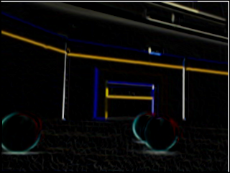
Segmenting Objects
Group same-colored regions using connected component labeling, and use edges to segment objects further?
Fit lines or curves to edges?
3
1
2

Slide 28
Classifying Objects
Consider the shape: rounded boundary, vs straight boundary
Consider the region around the center: red/yellow or not?
Consider special cases: goals with balls in the middle, goals observed at an angle, etc.
What if a ball is on the far side of a wall?

Slide 29
Classifying Objects (Color)
We've already talked about HSV, which can be very useful to classify color.
What should the robot "see" if we show it a yellow ball? (Nothing. Probably a passing baseball cap or something.)
Conversely, the only difference between a green ball and a red ball is color.
MORAL: We colored things to make it easy for you. Don't forget to consider color as a preprocessing tool.

Slide 30
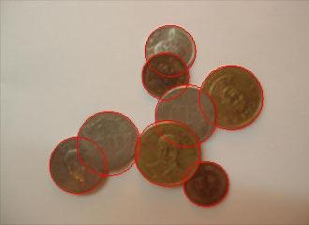
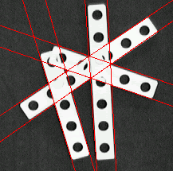
Classifying Objects (Shape)
Given all our previous techniques, how can we recognize the shape of an object?

Slide 31
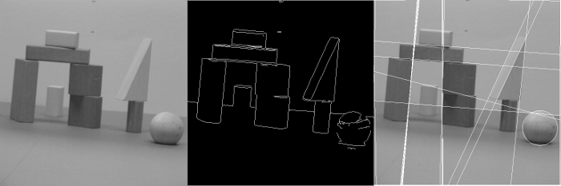
Hough Transform
Recognizes Shapes in edge images.
Lines are simplest, but will also work for circles and ellipses.
Not very fast (but still usable)
  If you have problems, run on smaller images at slower intervals so it isn't a bottleneck.
    If you're mapping walls on the side, you might only need to look for walls once each second or so.

Slide 32
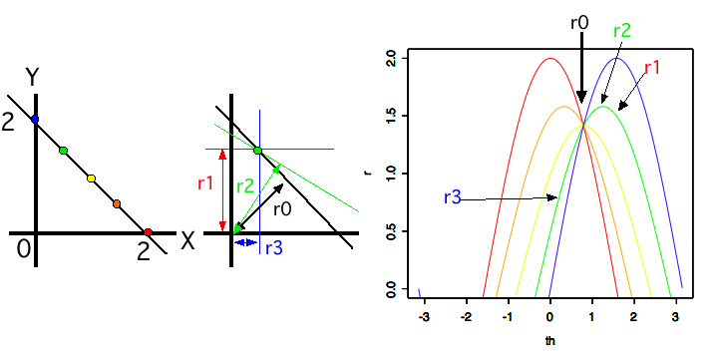
Hough Transform
Flips the problem around: to find lines in an image, think about all the possible lines through each point, see which ones crop up.

Slide 33
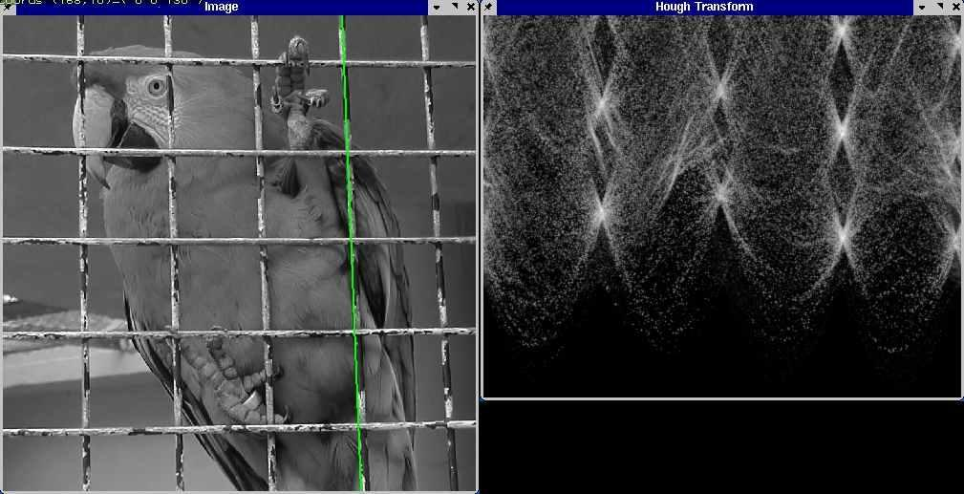
Hough Transform
Common method: Bin r, theta values, look for local maxima.
Bright points below correspond to the bars.

Slide 34
Hough Transform
OpenCV includes Hough Transform modules (and many other similar techniques). Use them, they're properly optimized and therefore fast(ish).
Shape is important for advanced image processing, but consider other options (i.e. head towards red segments.)

Slide 35

Estimating Distances to Objects
Note that all balls have the same size. Likewise with goals, wall heights, etc
By making some measurements and using some trig, you can estimate distance to objects from your image data nicely.
You can make all sorts of reasonable approximations. (i.e. distance is linear in the size of the image of the ball).
Image plane
Image of ball
Distance to ball center
~1 ball diameter

Slide 36
Testing Advice
Keep a collection of images which you can use unit tests on (There are some from us in the staff repository).
Test detection of balls and goals from different angles, and arrange in various ways
Make sure to test your vision code (especially color detection) in different lighting conditions. Try not to require too much calibration for this.

Slide 37
Other Resources
Connected Component Labeling: http://homepages.inf.ed.ac.uk/rbf/HIPR2/label.htm
Edge Detection: http://www.pages.drexel.edu/~weg22/can_tut.html
Various lectures from previous years also have info on camera details, performance optimizations, stereo vision, rigid body motion, etc
  http://web.mit.edu/6.186/2010/lectures/vision.pdf
  http://web.mit.edu/6.186/2007/lectures/vision/maslab-vision.ppt
  http://web.mit.edu/6.186/2006/lectures/Vision.pdf
  http://web.mit.edu/6.186/2005/doc/basicvision.pdf
  http://web.mit.edu/6.186/2005/doc/morevision.pdf
  http://courses.csail.mit.edu/6.141/spring2008/pub/lectures/Vision-I-Lecture.pdf

